Slide 1
Introduction to Microprocessor Design
PicoBlaze and PicoCtrl (which are completely unrelated!)‏

Slide 2
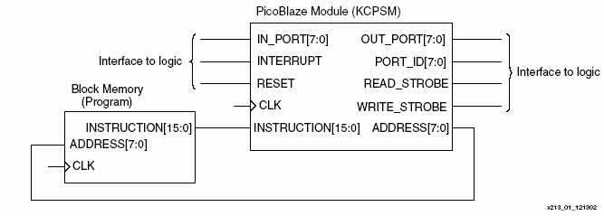
Picoblaze

Slide 3
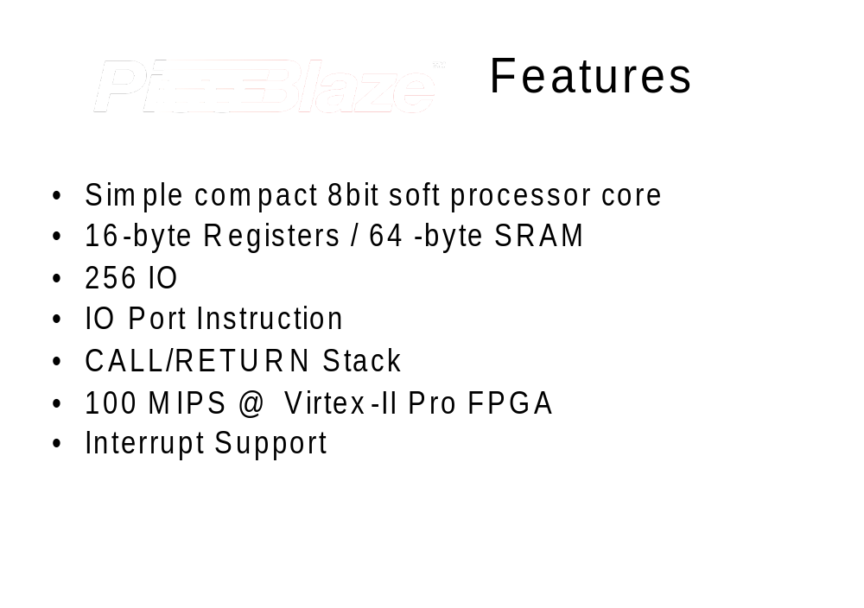

Slide 4
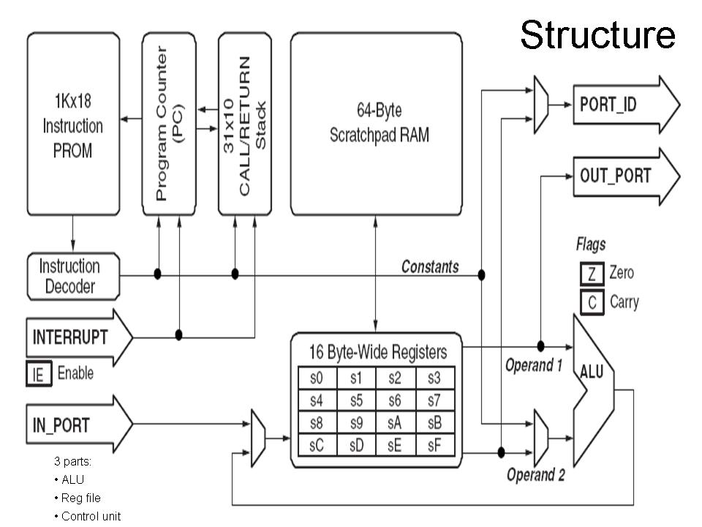
PicoBlaze – Internal Structure

Slide 5
System Architecture
PicoBlaze
Device
Port ID
In port
Out port
Read Strobe
Write Strobe
Interrupt
Instruction
Memory
Address
Instruction
Reset
Clock

Slide 6
What is a microprocessor?
A microprocessor is an FSM
It has a program, composed of instructions, which is stored in a ROM or RAM
It has inputs and outputs which the program controls.
The microprocessor executes the instructions one after the other
There is flow control (“Jump” instructions, conditional and/or unconditional.

Slide 7
What is a microprocessor?
There is nothing magical in implementing a microprocessor
Actually, the FSM of many microprocessors is rather simple
Before using the PicoBlaze, we will first study the PicoCtrl (originally developed by Jakub Šťastný, Ph.D. y Petr Bílý from the Czech Technical University in Prague).
It is a VERY simple processor but it will help us immensely in understanding how microprocessors function.

Slide 8
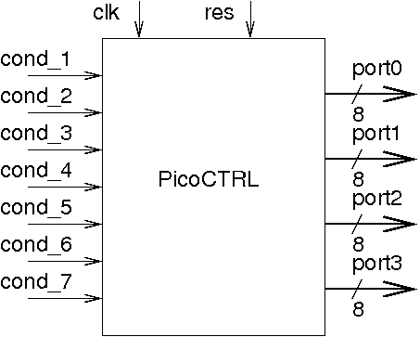
PicoCtrl Top Level

Slide 9
PicoCtrl
The PicoCtrl only has 2 instructions – WRITE and JUMP
The JUMP can be conditional
It has 4 registers that are also outputs
A small ROM of 32 instructions contains the program.
It has 1 PC register (Program Counter)‏
Every instruction is 16 bits wide

Slide 10
FSM of the PicoCtrl
The FSM that controls the PicoCtrl only has two states:
  FETCH (get the next instrucction from the ROM)‏
  EXECUTE (execute the instruccion)‏
Actually, these are exactly the two states of the FSM of the PicoBlaze
So, by understanding how the PicoCtrl works, we will be able to also understand how the PicoBlaze works, and then, by extension, how all microprocessors work.

Slide 11
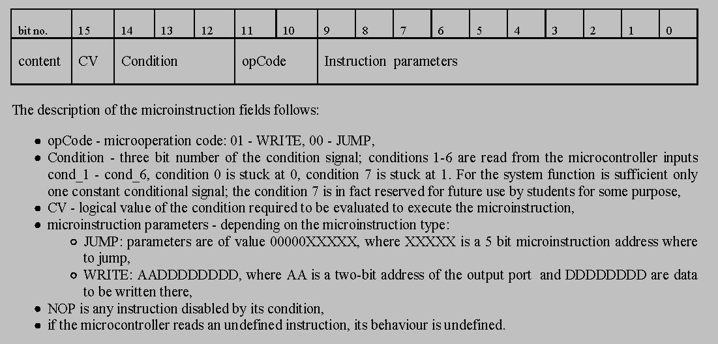
Instruction Format

Slide 12
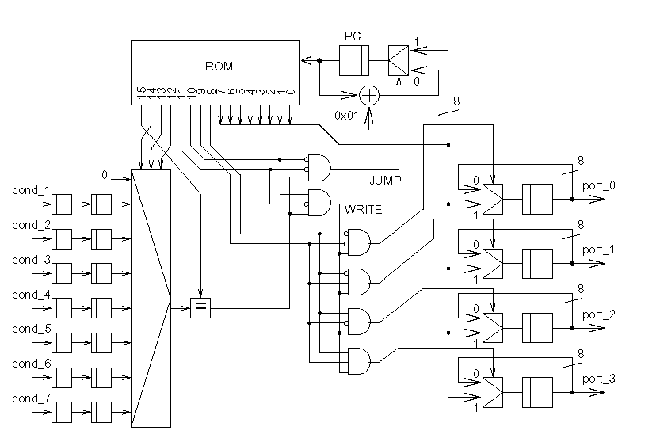
Pico Ctrl – Complete Scheme

Slide 13
Verilog code of the PicoCtrl
Now lets go to Quartus to see how the PicoCtrl Verilog code looks like.

Slide 14
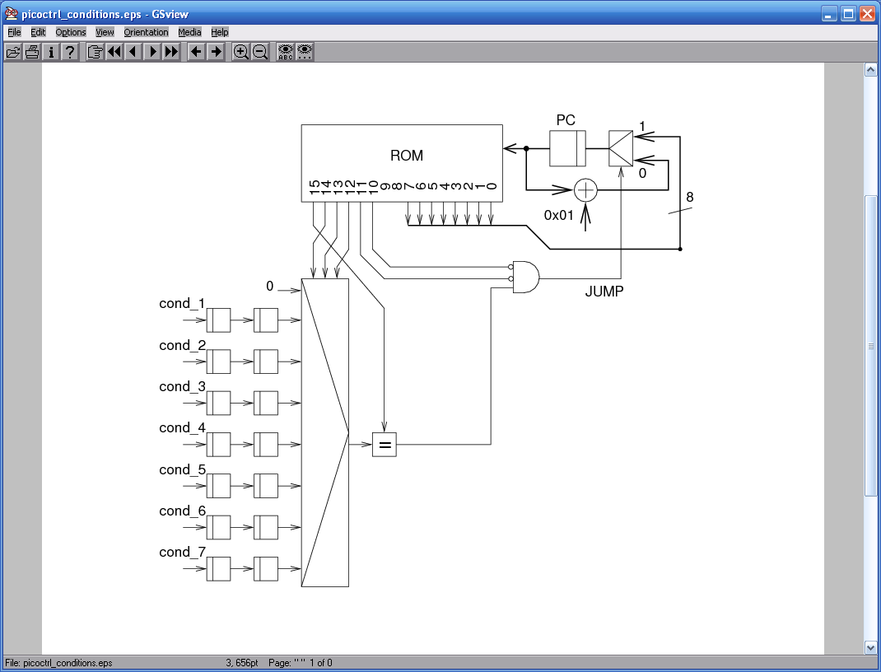
Program Counter Control

Slide 15
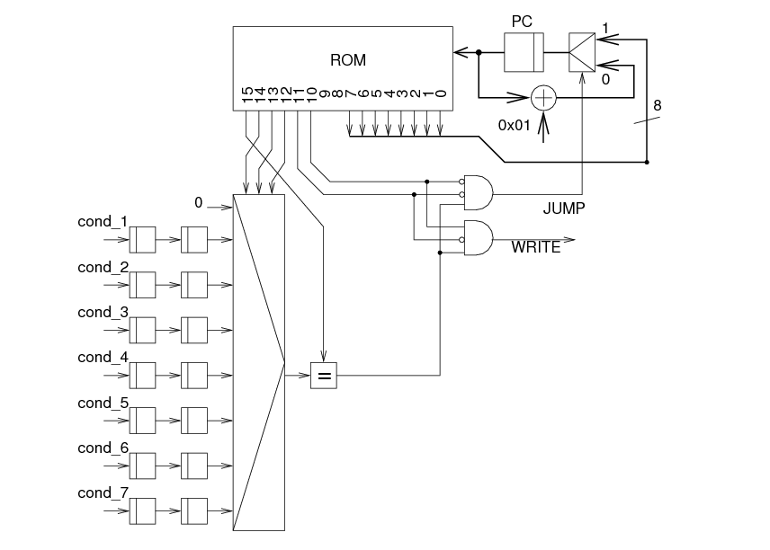
Write and Program Counter Control

